Slide 1

Human resources slide 1
Ibm Dashboard for Airport Company Data
Submitted by:
NAME- Gaurav Rao
Roll no-202310101150095
Course- Btech Cs(Ds+Ai)

Slide 2
Human resources slide 1
Project overview
In this project we discuss about a Airport employee details and his flight details .
Objecives of this analysis to know details about employee of this company and flight Details.

Slide 3









Human resources slide 2
Ibm cognos dashboard-: Cognos Dashboards provides a graphical canvas for a business user to investigate data for patterns and insights.
Employee Data Analysis- :
Key insight what we see in our dashboard-
Gender diversity
Marital status
Factor affecting job exprience
Avarage (Monthly Income by Gender)
Job Experience by Grade colored by Gender

Slide 4
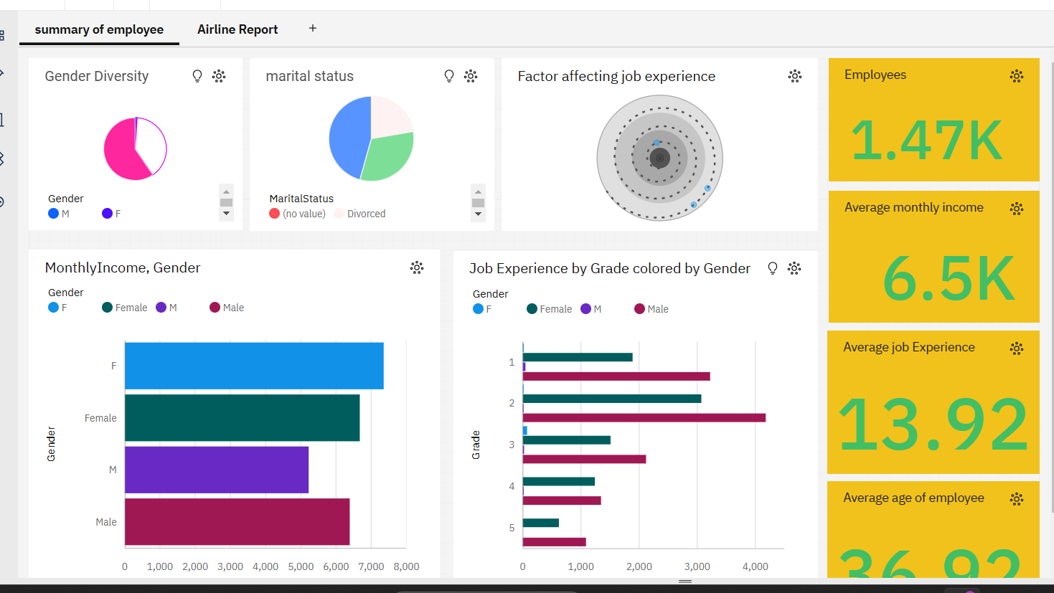
Human resources slide 3

Slide 5


Human resources slide 4
Airports Data dashboard
Key insight what we see in our dashboard-
i)Airports name in data runner
ii)Airlines name
iii)Carrier delay
iv)Weather delay
v)Security delay
vi)Arlines Cancelled by airport name and many more…..

Slide 6
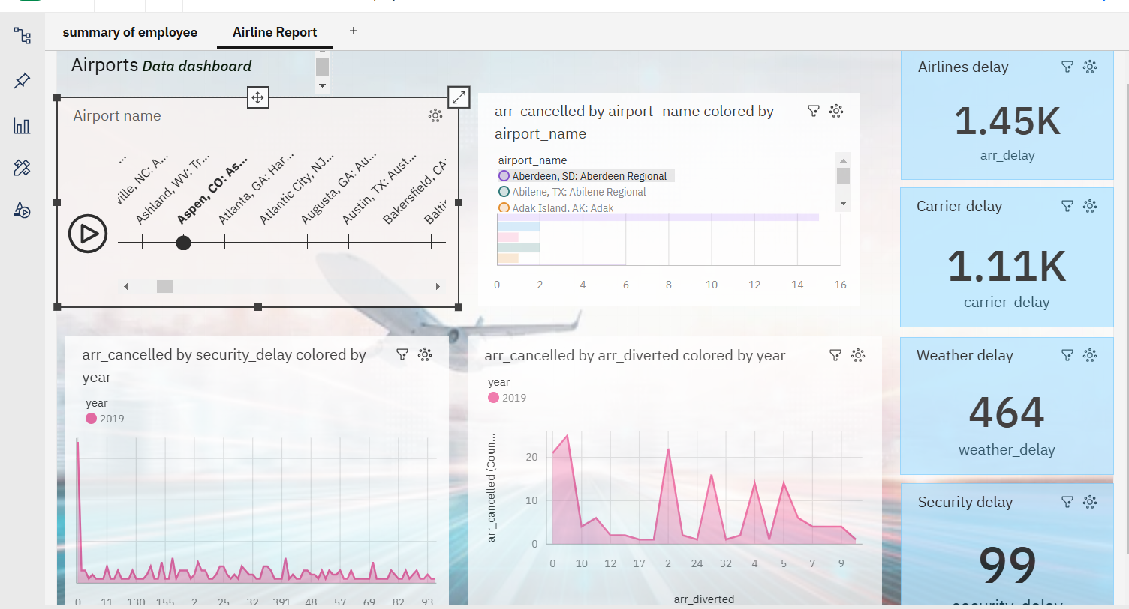
Human resources slide 4

Slide 7

Human resources slide 9
Conclusion
our analysis of the IBM dashboard for the airport company highlighted key insights into employee performance and airplane delays.The company can improve both operational efficiency and increase customer satisfaction.
n
n

Slide 8
Human resources slide 10
Thank You
For giving me this opprtunity

